Slide 1

Title: Food Trends Understanding Customer Preferences
INFOSYS SPRINGBOARD
VIRTUAL INTERNSHIP 6.0
BATCH- 11 | GROUP- 1
Name: Raghav Vyas Mentor Name: Nityasree J

Slide 2

Objective
The main objective of this project is to analyze restaurant and food-related data to identify customer behavior, food trends, restaurant performance, and quality consistency using interactive Power BI dashboards.
This project aims to:
Transform raw restaurant data into meaningful insights
Understand ordering patterns and customer preferences
Evaluate restaurant performance and quality stability
Support data-driven decision-making using visual analytics

Slide 3

Project Description
This project focuses on analyzing a real-world restaurant and food ordering dataset using Power BI to identify meaningful trends and performance patterns. The project involves data collection, cleaning, transformation, and visualization to convert raw data into actionable insights.
Interactive dashboards were developed to analyze customer behavior, food category trends, restaurant performance, and quality consistency. The project emphasizes data-driven decision-making by presenting insights through KPIs, comparative visuals, and trend analysis, enabling stakeholders to understand business performance and customer preferences effectively.

Slide 4

Dataset Overview:
Dataset Type: Zomato_restaurants
Source: Kaggle (Public Dataset)
Format: CSV file
Records include:
Orders
Ratings
Categories
Customers

Slide 5




Top Visualizations Used
Bar Charts: Compare values across different categories.
KPI Cards: Highlight key performance metrics at a glance.
Scatter Plot: Shows the relationship between two variables.
Line Charts: Display trends over time.
Donut Chart: Shows percentage distribution of categories.

Slide 6
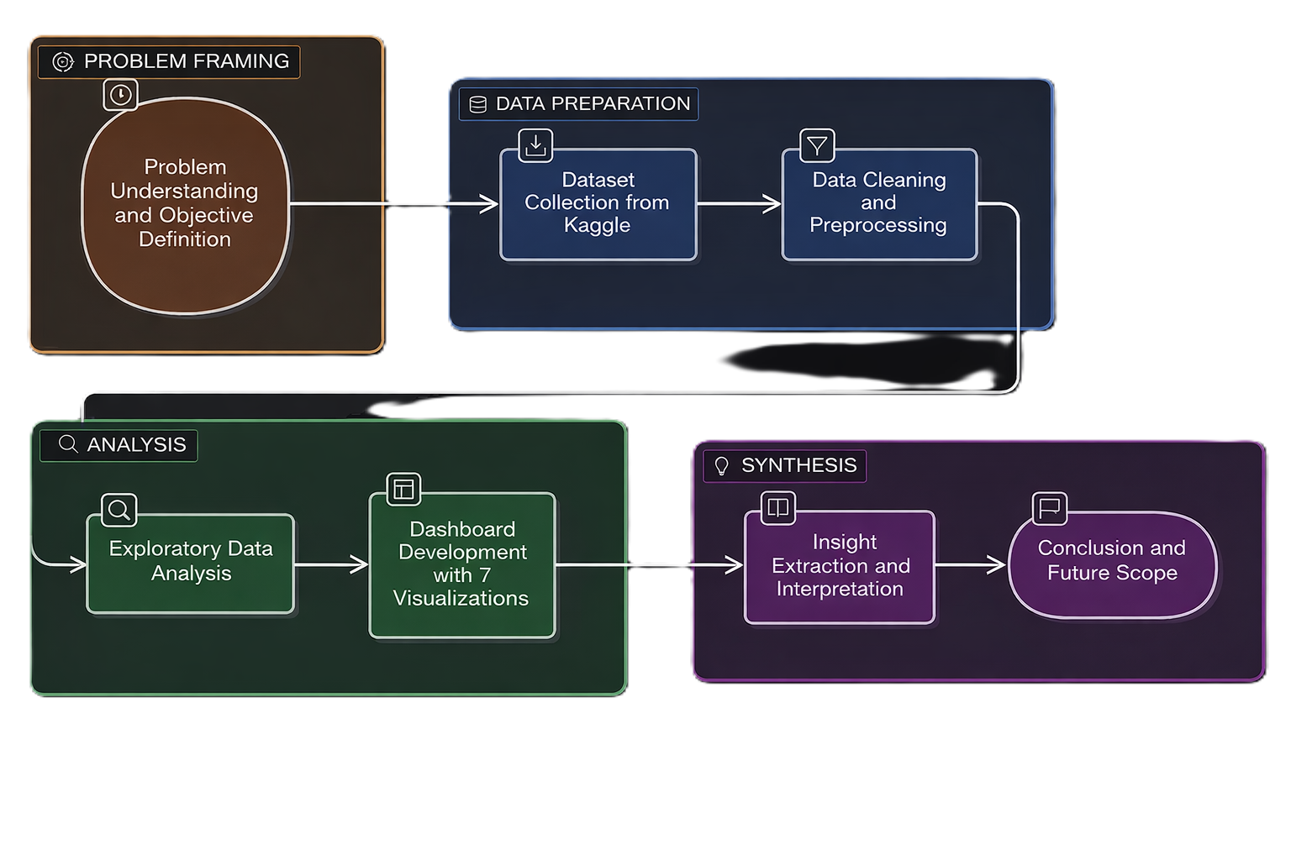
Workflow

Slide 7

Project Execution Milestones
Milestone 1: Data Preparation & Transformation: Collected dataset from Kaggle, cleaned and transformed data using Power BI Power Query, and created calculated columns and measures.
Milestone 2: Core Dashboard Development: Designed interactive dashboards to analyze business performance, customer behavior, and restaurant performance using KPIs and trend visuals.
Milestone 3: Food & Category Trend Analysis: Analyzed food categories, popular items, ordering patterns, and rating trends through category-wise visualizations.
Milestone 4: Strategic Insights & Optimization: Derived actionable insights on restaurant consistency and customer satisfaction, optimized dashboards, and completed project documentation.

Slide 8

Challenges Faced & Resolution
Challenge 1: Inconsistent and missing data
Resolution: Applied data cleaning techniques and standardized values during preprocessing
Challenge 2: Understanding meaningful KPIs
Resolution: Identified business-relevant metrics such as order frequency, ratings, and consistency scores
Challenge 3: Dashboard clutter and readability
Resolution: Optimized layout, reduced unnecessary visuals, and used slicers for better interactivity
Challenge 4: Performance optimization in Power BI
Resolution: Used optimized measures, reduced redundant columns, and improved data model relationships

Slide 9

Learning from the Project
Data cleaning is foundational: Quality preprocessing determines analysis reliability and outcome validity
EDA reveals patterns: Systematic exploration uncovers hidden relationships and business opportunities
Storytelling drives value: Effective dashboards transform raw data into compelling business narratives
Tools enable insight: Hands-on experience with Power BI and analytics platforms deepens technical proficiency

Slide 10
Key Insights
Top Revenue Cities: Delhi and Bangalore lead overall performance, with Delhi alone contributing over ₹105M in revenue, showing high urban demand concentration.
Peak Ordering Day: Friday records the highest order volume (~34.5K orders), while Sunday shows comparatively lower activity, indicating weekday-end ordering peaks.
Customer Demographics: The average customer age is ~24 years with an average family size of 3, confirming Gen Z and young millennials as the primary customer base.
Cuisine & Item Preference: North Indian and Chinese cuisines dominate total orders, with high-frequency items like Veg Pakoda showing consistent demand for affordable comfort food.
Growth & Retention Trend: Data from 2018–2020 indicates market stabilization after rapid growth, suggesting future revenue growth will be driven more by customer retention than expansion.

Slide 11

Feature Enhancements
Interactive Filtering:
Dynamic slicers for city, restaurant, cuisine, and date to support drill-down analysis.
KPI Snapshot View:
KPI cards displaying revenue, orders, ratings, and customer count for quick insights.
Trend & Growth Analysis:
Time-based visuals to track revenue, order trends, and seasonal patterns.
Performance Comparison:
Comparative visuals to evaluate restaurant performance and quality consistency.

Slide 12

Conclusion
Successfully analyzed a real-world restaurant dataset using Power BI to uncover meaningful food and customer trends.
Identified high-revenue cities, peak ordering patterns, and dominant cuisines, supporting data-driven business decisions.
Demonstrated the impact of restaurant consistency and quality on customer retention and overall performance.
Developed interactive, scalable dashboards that enable quick insights, comparison, and trend analysis.

Slide 13
Acknowledgement & Reference
We would like to express our heartfelt gratitude to:
Infosys Springboard Team– for organizing this valuable internship opportunity.
Our Mentor– for her continuous support and feedback.
My Teammates – for collaboration, encouragement, and insights
This internship has been a significant step in our professional growth and technical journey.
References:
Microsoft Power BI Documentation
Infosys Springboard Virtual Internship course materials

Slide 14
THANK YOU

